Slide 1
MATHEMATICAL INSIGHTS OF T-SNE AND UMAP
Explanation of Mathematics involved in two non-linear dimensionality reduction techniques for unsupervised learning
Team Members:
Aditya Krishna Das
Yasaswani Rongali
Yash Kumar

Slide 2
DIMENSIONALITY REDUCTION: WHAT AND WHY?
01
PRINCIPAL COMPONENT ANALYSIS
02
WHAT WILL THIS PRESENTATION COVER?
t-SNE
03
UNDERSTANDING UMAP
04
Understanding in brief about one of the most widely used DR techniques
Understanding steps involved in t-SNE
A dig into UMAP theory

Slide 3
01
DIMENSIONALITY REDUCTION: WHAT AND WHY?

Slide 4
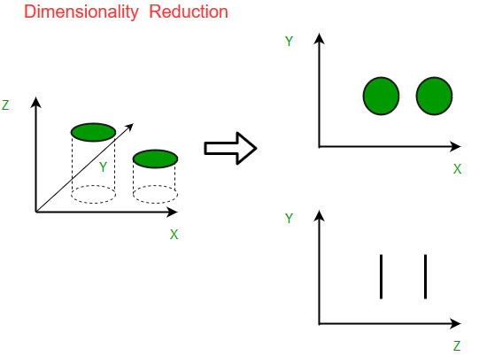
WHAT IS DIMENSIONALITY REDUCTION?
Dimensionality reduction is the process of reducing the number of random variables under consideration, by obtaining a set of principal variables.
In simpler words, Dimensionality reduction is nothing but the reduction of n dimension data to n’ dimension data, where n > n’.

Slide 5
WHY USE DIMENSIONALITY REDUCTION?
Saves computational resources:
As dimensionality reduction reduces the training time of models by simplifying calculations, the need for computational resources to train those models will be very low.
Visualization of high-dimensional data:
When we reduce the dimensionality of higher dimensional data into two or three components, then the data can easily be plotted on a 2D or 3D plot.
Mitigate the problem of overfitting:
Dimensionality reduction finds a lower number of variables or removes the least important variables from the model.

Slide 6
02
PCA
Understanding in brief about one of the most widely used DR techniques

Slide 7
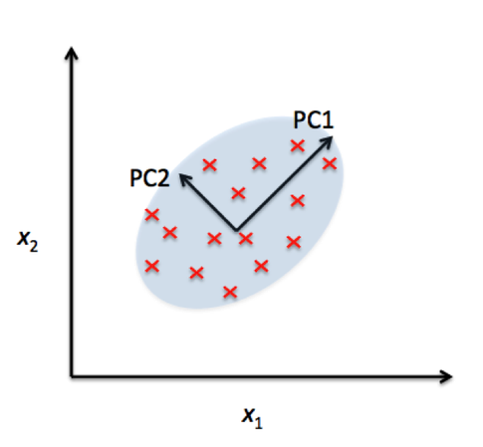
PRINCIPAL COMPONENT ANALYSIS
The idea of PCA is simple — reduce the number of variables of a data set, while preserving as much information as possible.
Standardize the Data
Computation of covariance matrix.
Computation of the eigen values and eigen vectors of the covariance matrix to identify the principle components

Slide 8
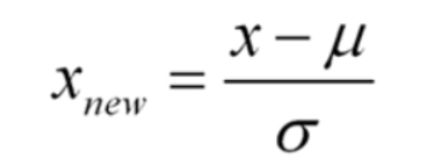
PCA
Let X be a m cross n matrix
Where m is the number of data points and n is the number of dimensions
XP=Y
Here P is the transformation matrix and Y is the transformed dataset which has lesser number of dimensions.
STEP 1:
The data is standardized.
STEP 2:
Covariance matrix is found using the formula:
X^{T}X/m
STEP 3:
Eigen values and Eigen vectors of the covariance matrix are calculated.

Slide 9
03
t-SNE
Understanding steps involved in t-SNE

Slide 10
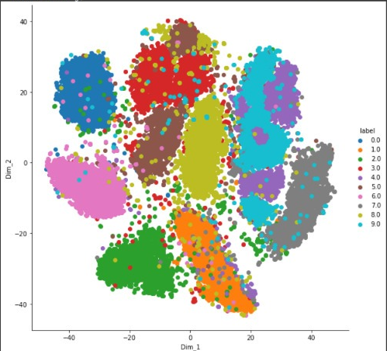
t-DISTRIBUTED STOCHASTIC NEIGHBOUR EMBEDDING
t-Distributed Stochastic Neighbor Embedding (t-SNE) is an unsupervised, non-linear technique primarily used for data exploration and visualizing high-dimensional data.
In simpler terms, t-SNE gives you a feel or intuition of how the data is arranged in a high-dimensional space.

Slide 11
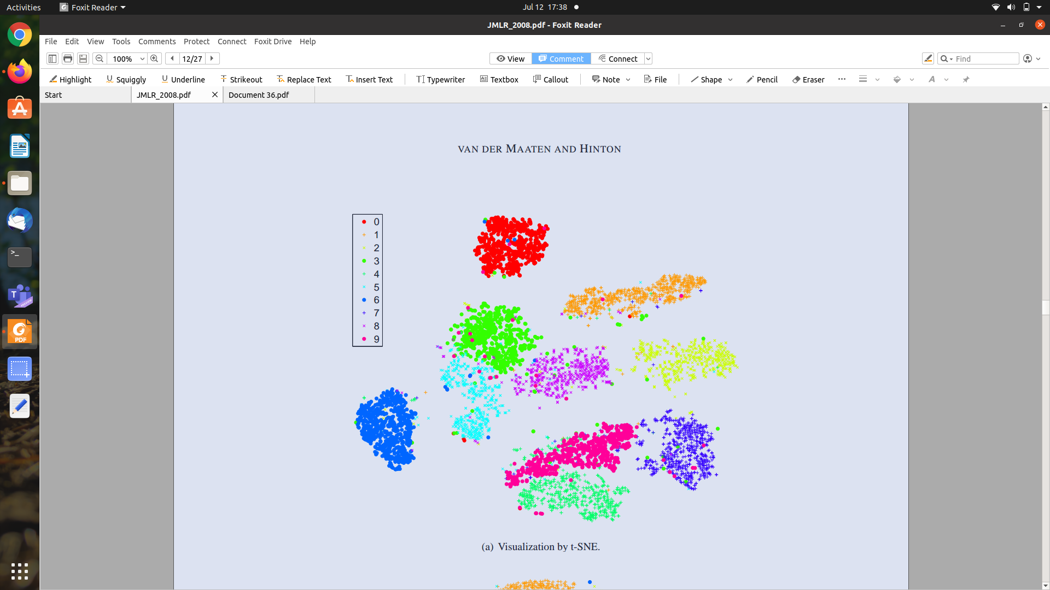
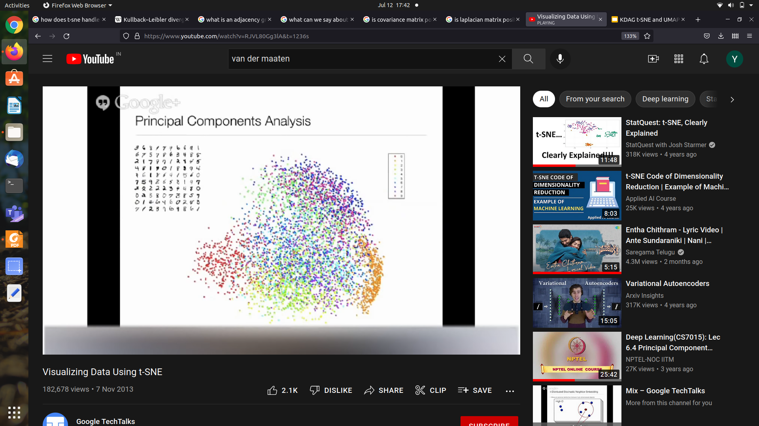
t-SNE can handle outliers whereas PCA is highly influenced by outliers present in the data.
t-SNE does a better job (it tries to preserve topology neighbourhood structure) as compared to PCA when it comes to visualising the different patterns of the clusters.
Why is t-SNE better than PCA?
Visualization by PCA

Slide 12
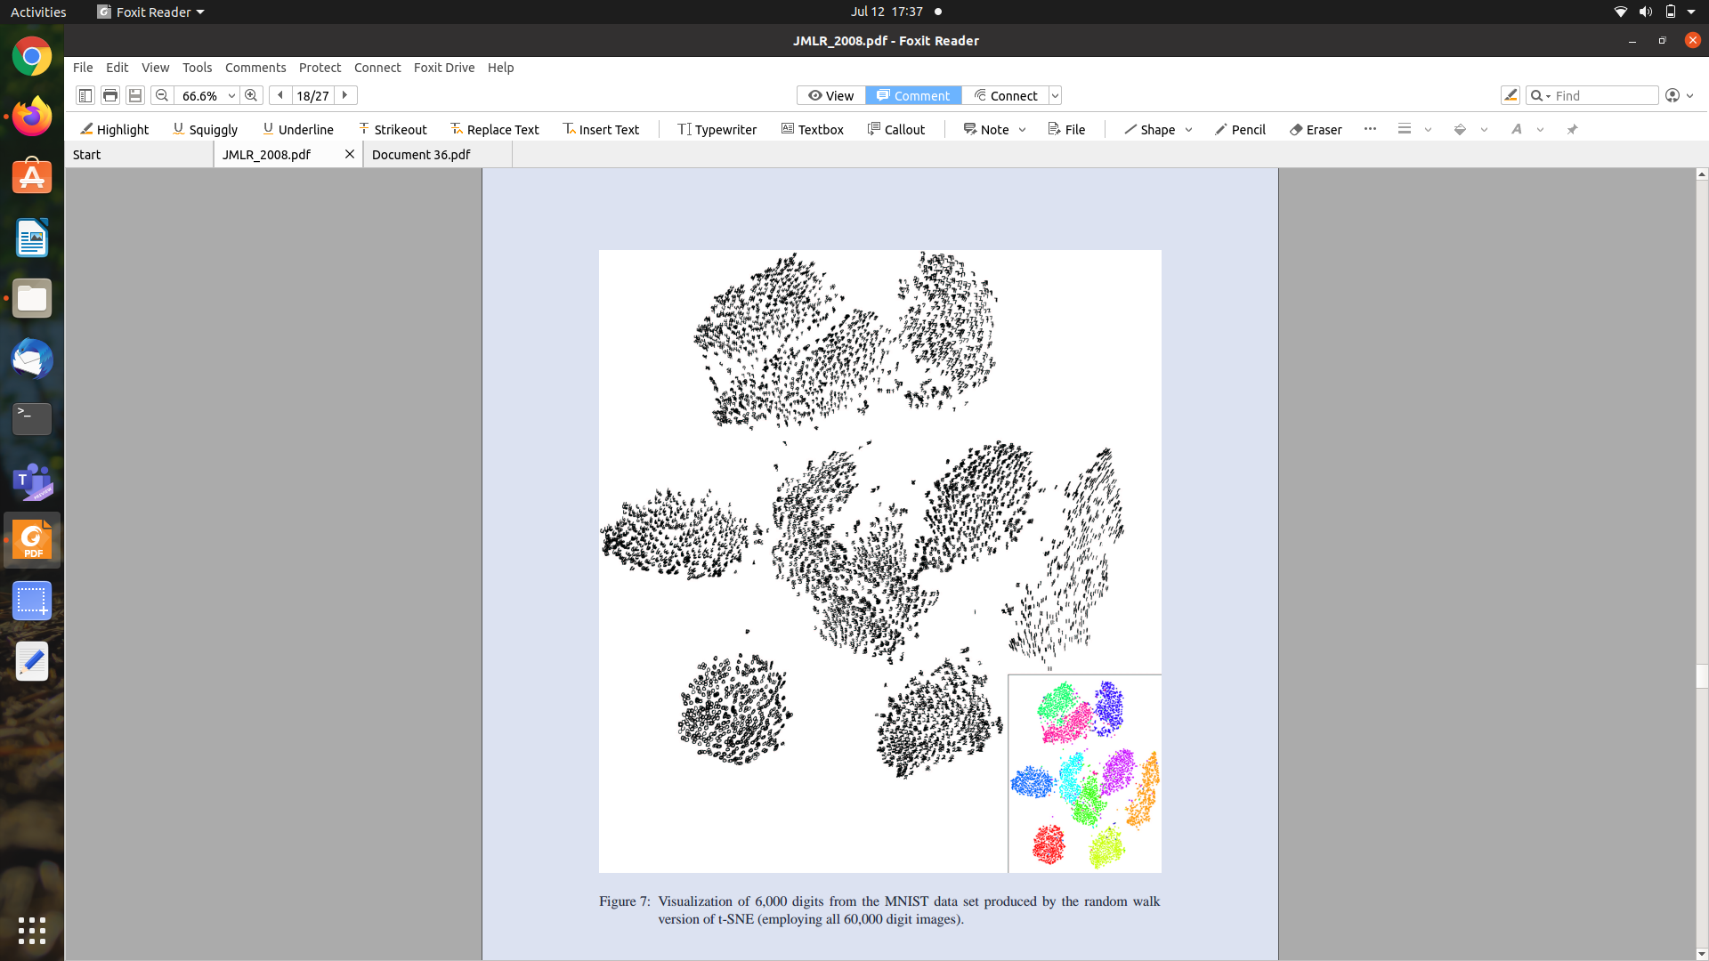

Slide 13
Algorithm of t-SNE
Calculating conditional probability distribution of pairs of points from high dimensional data
Computing joint probability distribution by taking the average of conditional probability distribution for a pair of points
Creating a dataset of points in the target dimension and then calculating the low dimensional joint probability distribution for them.
Computing Cost Function
Using Gradient Descent and momentum to move the points in the low dimensional graph after each iteration.

Slide 14
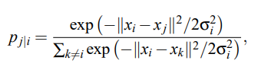
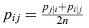
CALCULATION OF CONDITIONAL PROBABILITY AND TAKING THEIR AVERAGE
The similarity of datapoint x_{j} to datapoint x_{i} is the conditional probability, p_{j|i} , that x_{i} would pick x_{j} as its neighbor if neighbors were picked in proportion to their probability density under a Gaussian centered at x_{i} .
n=number of higher dimensions
If we sum p_{ij} for all points x_{j} other x _{i}, then for that point x_{i}, the sum would be equal to 1. By this, we get σ_{i}.
https://www.jmlr.org/papers/volume9/vandermaaten08a/vandermaaten08a.pdf

Slide 15
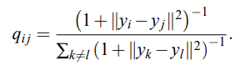
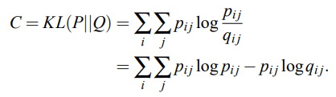
COMPUTING LOW DIMENSIONAL JOINT PROBABILITY DISTRIBUTION
The low dimensional graph is initialised randomly and the low dimensional joint probability distribution is calculated using the given formula.
The expression on the RHS is a Student t-distribution expression.
COMPUTING COST FUNCTION
Cost Function basically calculates the sum of difference of high dimensional and low dimensional joint probability distribution scores of all pairs of points.
https://www.jmlr.org/papers/volume9/vandermaaten08a/vandermaaten08a.pdf

Slide 16
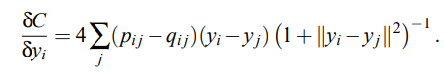
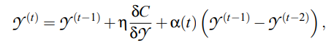
USING GD AND MOMENTUM TO UPDATE LOCATION OF POINTS IN THE LOW DIMENSIONAL GRAPH
Calculation of low dimensional joint probability distribution, gradient descent and the low dimensional data representation set is done in each iteration as after each iteration, position of all points change as they move towards their cluster and away from others.
Gradient Descent
Set containing low dimensional representation of data
https://www.jmlr.org/papers/volume9/vandermaaten08a/vandermaaten08a.pdf

Slide 17
04
UNDERSTANDING UMAP
A dig into UMAP theory

Slide 18
UNIFORM MANIFOLD APPROXIMATION AND PROJECTION
UMAP is a new dimensionality reduction technique that offers a number of advantages over t-SNE, most notably increased speed and better preservation of the data's global structure.
UMAP, at its core, works very similarly to t-SNE - both use graph layout algorithms to arrange data in low-dimensional space.
In the simplest sense, UMAP
Constructs a high dimensional graph representation of the data
Optimizes a low-dimensional graph to be as structurally similar as possible.
Notes:
To keep Fuzzy or not.

Slide 19
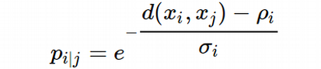
CALCULATION OF SIMILARITY SCORES
The first thing that UMAP does is calculate the distance between each pair of high dimension points. After this, the similarity scores are calculated by the formula:
Formula used in t-SNE:
d(x_{i}, x_{j})=Distance (need not be Euclidean distance) between points i and j
⍴_{i}=Distance of point i from its Nearest Neighbour
The value of 𝛔_{i} is chosen such that
Σp_{i|j} (for j=1 to n)=log₂(n) , where n=no. of nearest neighbours.
UMAP scales the curve so that regardless of how close or far the neighbouring points are, the sum of similarity scores will be equal to log₂(number of nearest neighbours).
https://towardsdatascience.com/how-exactly-umap-works-13e3040e1668

Slide 20
2. SYMMETRIZATION OF SIMILARITY SCORES
Since, there should be a unique similarity score for a pair of points, we apply symmetrization to p_{i|j} and p_{j|i} by using the formula given below.
These symmetric similarity scores are used for deciding the order in which points are chosen to be moved to form a cluster. Pair of points having higher symmetric similarity score are given preference.

Slide 21
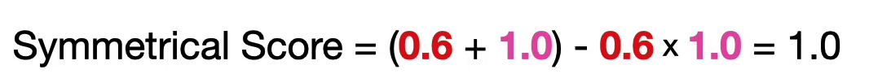
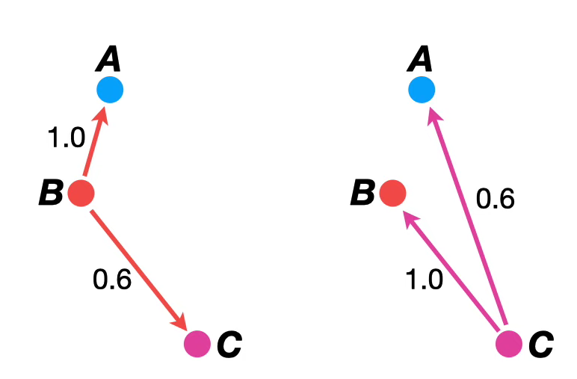
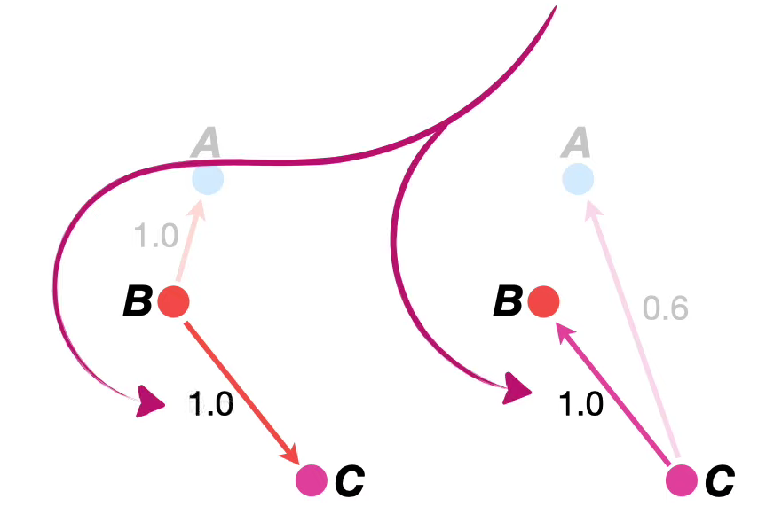
2. SYMMETRIZATION OF SIMILARITY SCORES
Example of symmetrizing HD similarity scores of points B and C.

Slide 22
3. LOW DIMENSIONAL(LD) SIMILARITY SCORES
NOTE: p and x refer to high dimension and q and y refer to low dimension
For calculating the low dimensional similarity scores of a pair of points, we use the formula:
q_{ij}=1/(1+a|y_{i}-y_{j}|^{2b})
The UMAP defaults use min_dist = 0.1, spread = 1, which results in a=1.577 and b=0.8951. If you use min_dist = 0.001, spread = 1 then you get the result for a=1.929 and b=0.7915.

Slide 23
WHY ARE LOW-DIMENSIONAL (LD) SIMILARITY SCORES USED?
AND HOW?
To form the clusters in the low dimensional graph.
LD similarity scores are used to know whether or not a point is in a proper position in the LD graph.
If a pair of points are neighbours in the HD graph, then they should have high LD similarity scores. So, after the LD graph is initialized UMAP brings neighbour points close to each other and this is judged by their similarity scores, that is, if their LD similarity score is increasing the points are getting closer. Similarly for pair of points that are not neighbours, UMAP tries to reduce their LD similarity scores and this is how clusters are formed.

Slide 24
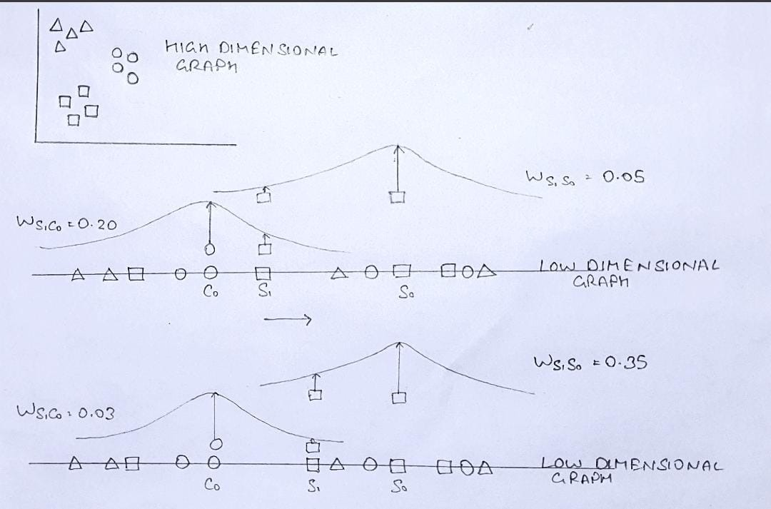
AND HOW?
In this example, a 2D graph is converted to 1D by being randomly initialised (just for the explanation here) and point S₁ is moved towards its neighbour S₀ and away from its not neighbour C₀.
(The LD joint probability values are random values used only for explanation.)

Slide 25
SPECTRAL EMBEDDING
In t-SNE the low dimensional graph is randomly initialised but in UMAP, the low dimensional graph is initialised using Spectral Embedding.
The Spectral Embedding (Laplacian Eigenmaps) algorithm consists of three stages:
Constructing the Adjacency Graph
Choosing the Weights
Obtaining the Eigenmaps
STEP 1: The first step is to construct an adjacency graph based on the given data. We put an edge between nodes i and j if the corresponding data-points are “close”. In UMAP two points are said to be close if one of them is among the N-nearest neighbours of the other.
https://medium.com/mlearning-ai/demystifying-spectral-embedding-b2368bba580

Slide 26
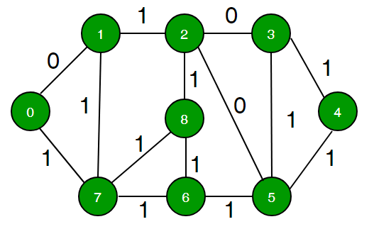
SPECTRAL EMBEDDING
STEP 2: While assigning weights we make Wᵢⱼ = 1 if vertices i and j are connected by an edge (that is, if they are among their nearest neighbours), otherwise put Wᵢⱼ = 0.
STEP 3: After the second step, we will have the weight matrix (W) with us. Using W, we will obtain the diagonal weight matrix (D), whose entries are column (or row, since W is symmetric) sums of W, i.e., Dᵢᵢ = ∑ⱼ Wⱼᵢ. Once we have obtained D, we will obtain the Laplacian Matrix (L), where L = D-W.
L f₀ =λ₀Df₀
L f₁ =λ₁Df₁
…
L fₖ -₁ =λₖ -₁Dfₖ -₁
where, f₀,f₁ … fₖ -₁, represent the eigenvectors to this problem, ordered according to their eigenvalues, i.e., 0 = λ₀ ≤ λ₁ … ≤ λₖ -₁.
From these k eigenvectors, we leave out the eigenvector f₀ corresponding to eigenvalue 0, and use the next m eigenvectors for obtaining the lower m-dimensional representations, i.e.,
xᵢ = [f₁(i), … fₘ(i)]

Slide 27
TWO IMPORTANT PARAMETERS OF UMAPs
We'll consider the two most commonly used parameters: n_neighbors and min_dist, which are effectively used to control the balance between local and global structure in the final projection.

Slide 28
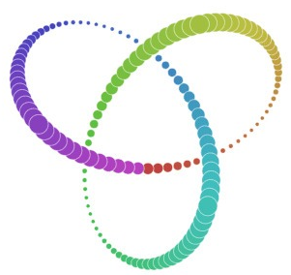
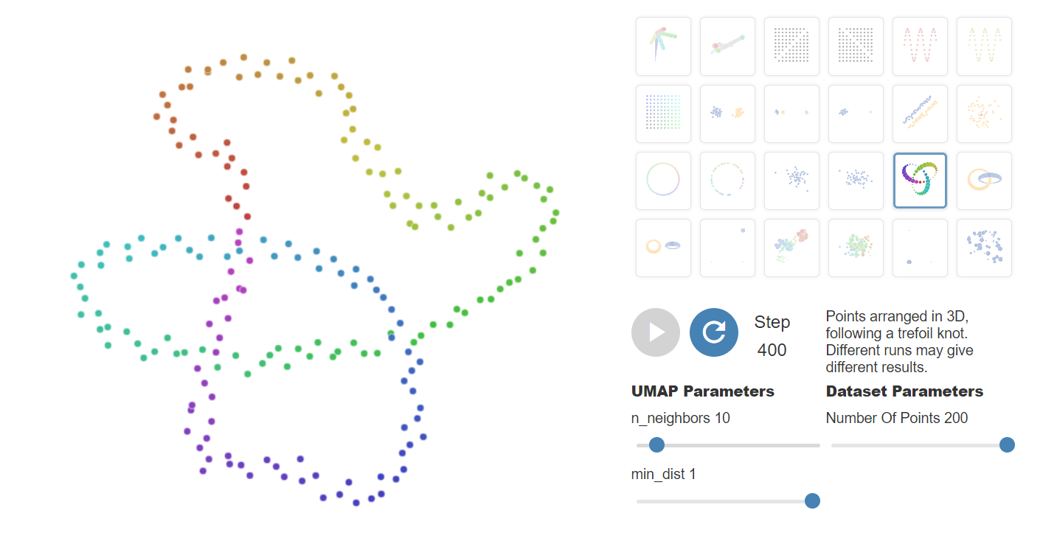
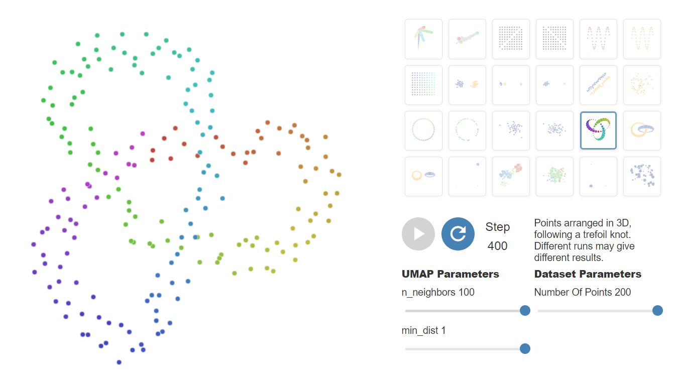
NUMBER OF NEAREST NEIGHBOURS
The most important parameter is n_neighbors - the number of approximate nearest neighbors used to construct the initial high-dimensional graph. It effectively controls how UMAP balances local versus global structure - low values will push UMAP to focus more on local structure by constraining the number of neighboring points considered when analyzing the data in high dimensions, while high values will push UMAP towards representing the big-picture structure while losing fine detail.

Slide 29
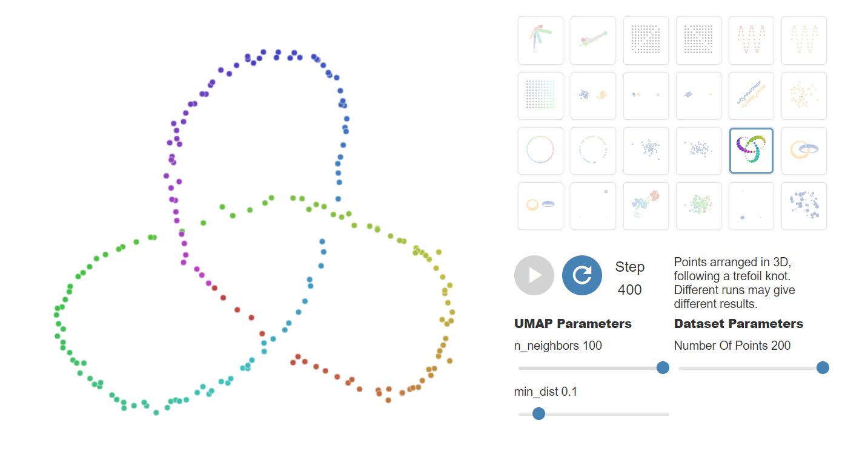
MINIMUM DISTANCE
The second parameter we’ll investigate is min_dist, or the minimum distance between points in low-dimensional space. This parameter controls how tightly UMAP clumps points together, with low values leading to more tightly packed embeddings. Larger values of min_dist will make UMAP pack points together more loosely, focusing instead on the preservation of the broad topological structure.

Slide 30
CODE FOR t-SNE
import numpy as np
import matplotlib.pyplot as plt
import pandas as pd
import seaborn as sn
import scipy as sp
from keras.datasets import mnist
(X_train, y_train), _ = mnist.load_data()
np.shape(X_train)
data = np.reshape(X_train,(len(X_train),784))
labels=y_train
data,labels
from sklearn.preprocessing import StandardScaler
std_data = StandardScaler().fit_transform(data)
print(std_data.shape)
from sklearn.manifold import TSNE
model = TSNE(n_components=2,perplexity=100,learning_rate=1000,n_iter=500, random_state=0)
tsne_data = model.fit_transform(data[:25000])
tsne_data = np.vstack((tsne_data.T, labels[:25000])).T
tsne_df = pd.DataFrame(data=tsne_data, columns=("Dim_1", "Dim_2", "label"))
sn.FacetGrid(tsne_df, hue="label", height=8).map(plt.scatter, 'Dim_1', 'Dim_2').add_legend()
plt.show()

Slide 31
OUTPUT OF t-SNE ON MNIST DATA

Slide 32
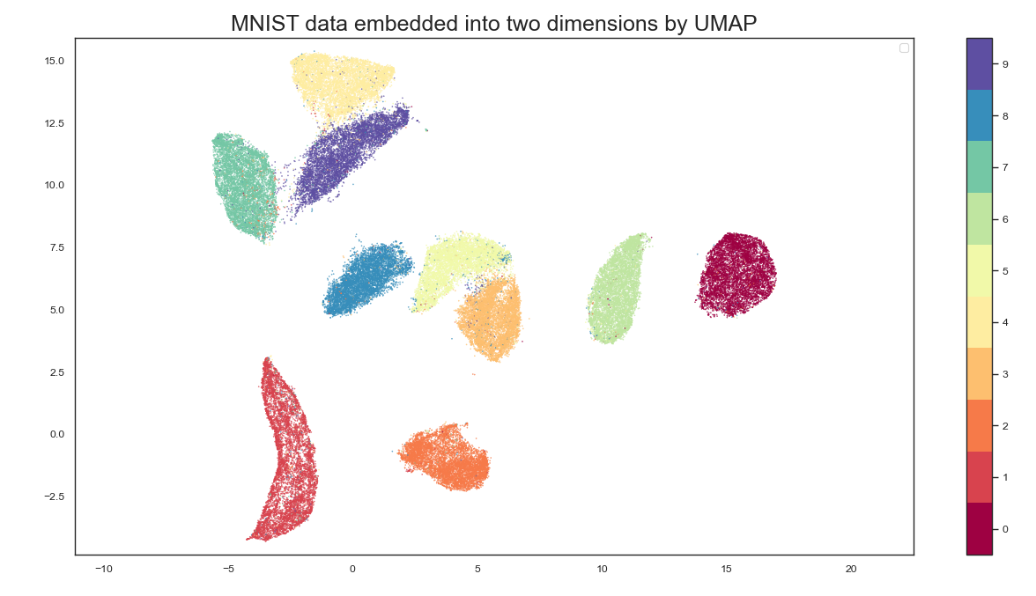
CODE FOR UMAP
import umap.umap_ as umap
from sklearn.datasets import fetch_openml
import matplotlib.pyplot as plt
import seaborn as sns
import numpy as np
sns.set(context="paper", style="white")
mnist = fetch_openml("mnist_784", version=1)
reducer = umap.UMAP(random_state=42)
embedding = reducer.fit_transform(mnist.data)
fig, ax = plt.subplots(figsize=(12, 10))
color = mnist.target.astype(int)
plt.scatter(embedding[:, 0], embedding[:, 1], c=color, cmap="Spectral", s=0.1)
plt.gca().set_aspect('equal', 'datalim')
plt.colorbar(boundaries=np.arange(11)-0.5).set_ticks(np.arange(10))
plt.title("MNIST data embedded into two dimensions by UMAP", fontsize=18)
plt.legend()
plt.show()

Slide 33
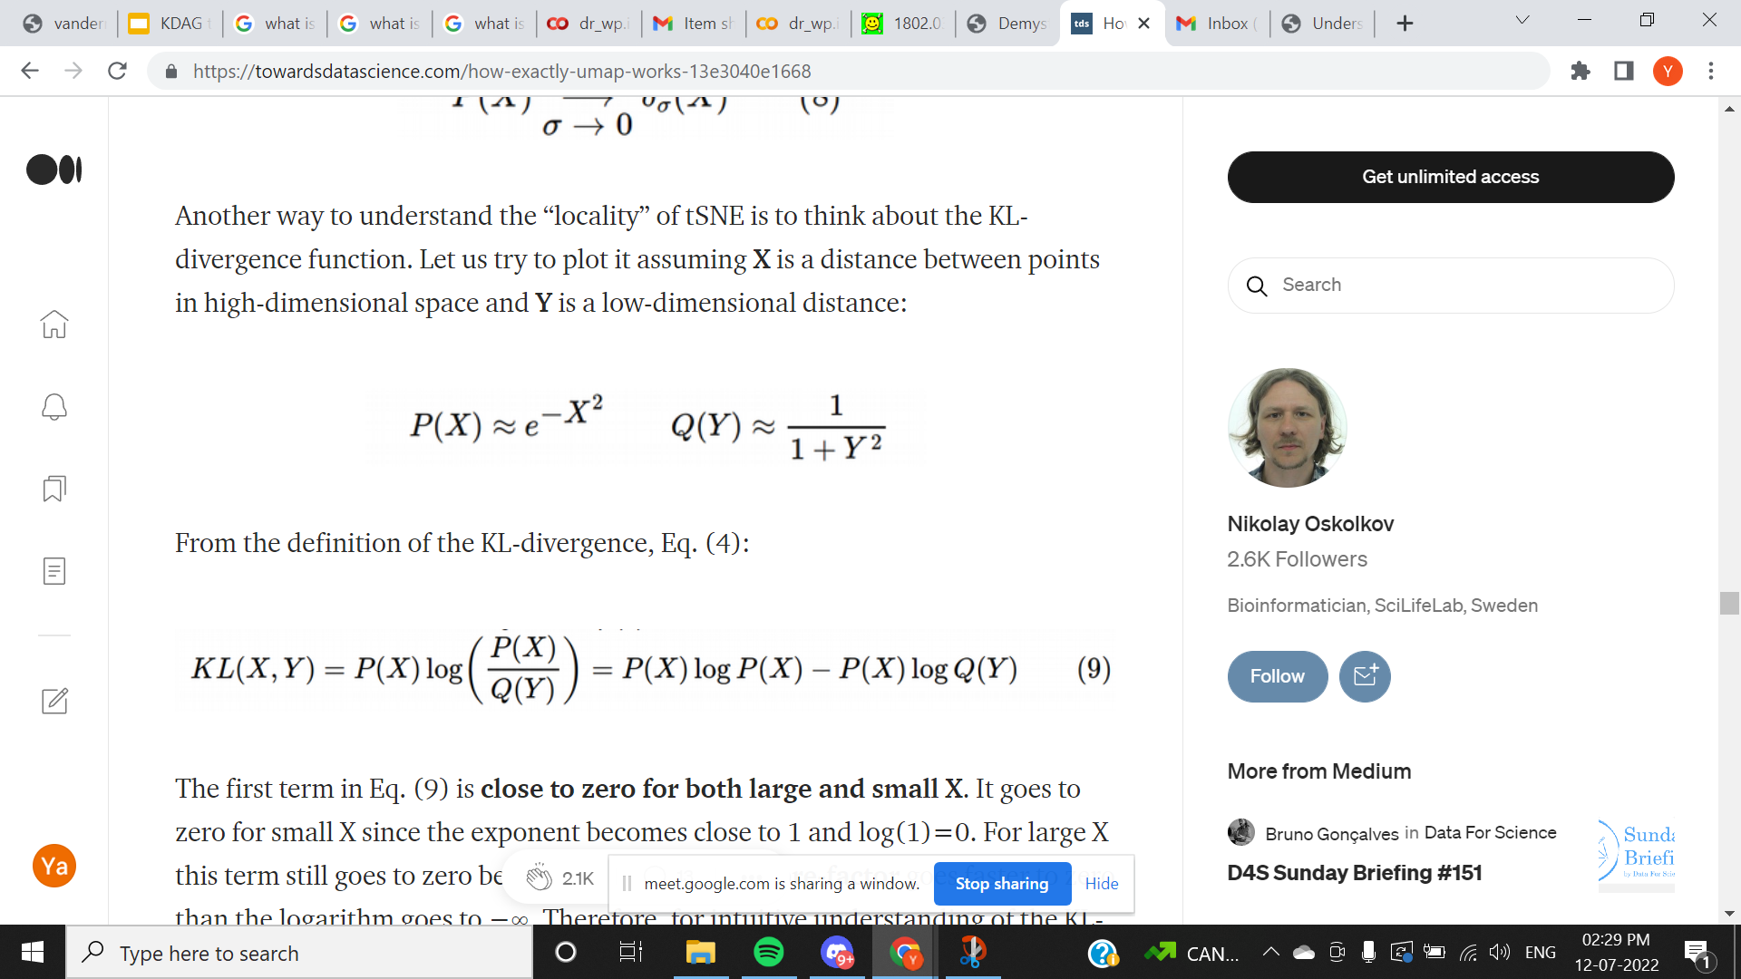
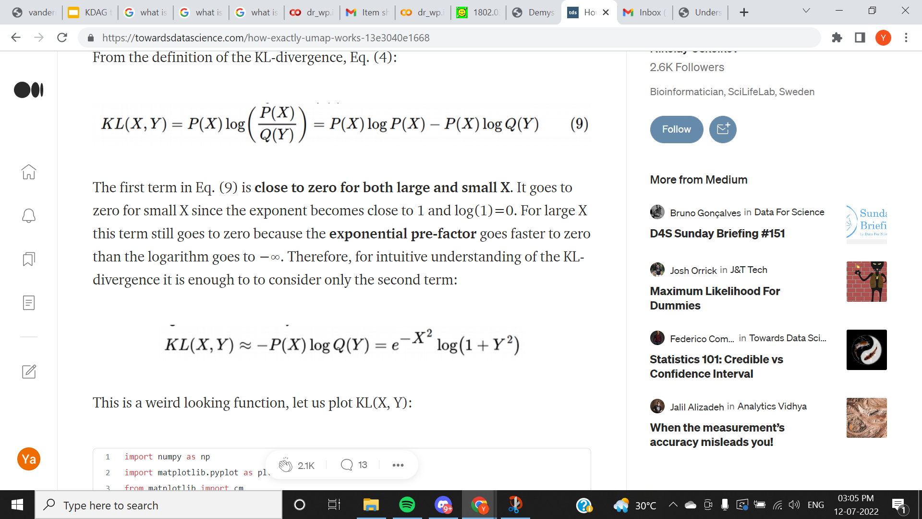
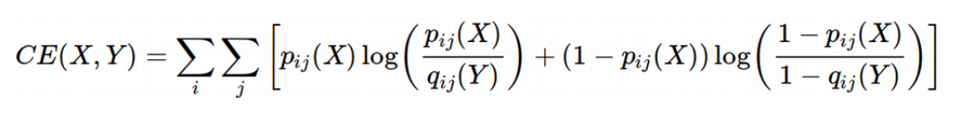
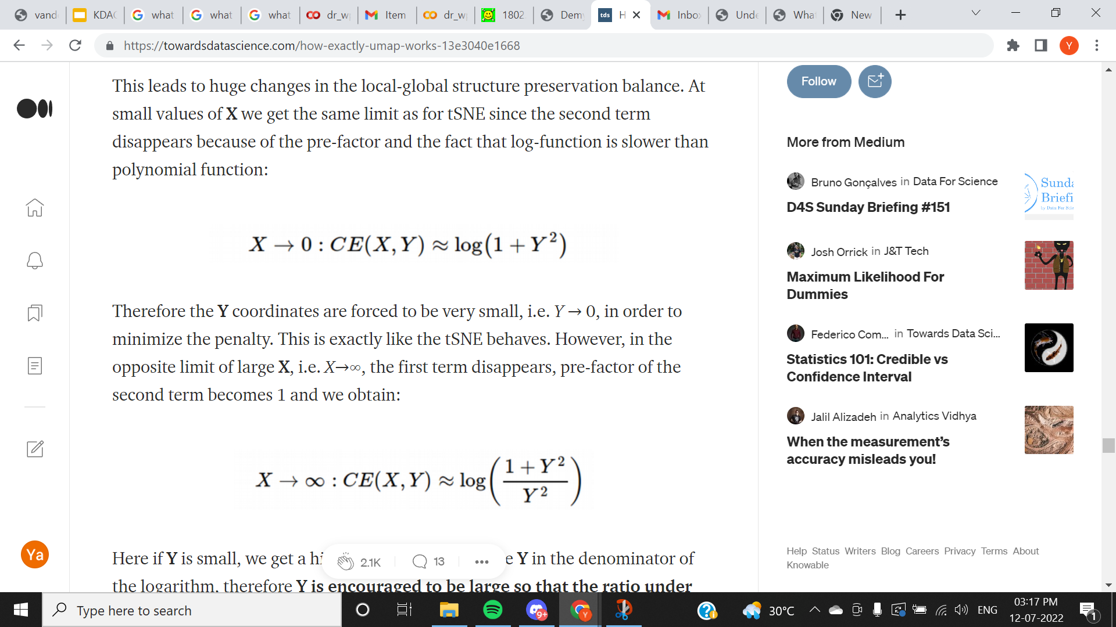
COMPARISON OF TWO COST FUNCTIONS
AND THEIR EFFECT ON LOCAL AND GLOBAL STRUCTURE
COST FUNCTION OF t-SNE
NOTE: p and x refer to high dimension and q and y refer to low dimension
1)
2)
3)
COST FUNCTION OF UMAP:
4)
6)
5)
https://towardsdatascience.com/how-exactly-umap-works-13e3040e1668

Slide 34
THANKS

